Slide 1



Chapter 1
The Human

Slide 2
Contents
Humans are limited in their capacity to process
information. This has important implications for design.
Information is received and responses given via a number of input and output channels:
– visual channel
– auditory channel
– haptic channel
– movement.

Slide 3
Contents (cont.)
Information is stored in memory:
– sensory memory
– short-term (working) memory
– long-term memory.
Information is processed and applied:
– reasoning
– problem solving
– skill acquisition
– error.

Slide 4
Contents (cont.)
Emotion influences human capabilities.
Users share common capabilities but are individuals with differences(since each person is different), which should not be ignored.

Slide 5
Vision
Two stages in vision
• physical reception of stimulus
• processing and interpretation of stimulus

Slide 6
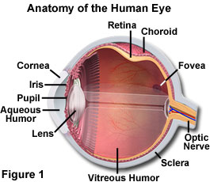
The Eye - physical reception

Slide 7
The Eye - physical reception(cont.)
mechanism for receiving light and transforming it into electrical energy
light reflects from objects
images are focused upside-down on retina
retina contains rods for low light vision and cones for colour vision
ganglion cells (brain!) detect pattern(X-cells) and movement(Y-cells).
The distribution of these cells means that, while we may not be able to detect changes in pattern in peripheral vision, we can perceive movement.

Slide 8
Interpreting the signal
Size and depth
visual angle indicates how much of view object occupies (relates to size and distance from eye)
visual acuity is ability to perceive detail (limited)
familiar objects perceived as constant size (in spite of changes in visual angle when far away)
cues like overlapping help perception of size and depth

Slide 9
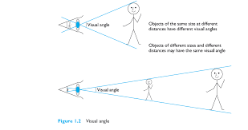
Interpreting the signal (cont)

Slide 10
Interpreting the signal (cont)
Brightness
subjective reaction to levels of light
affected by luminance of object
measured by just noticeable difference
visual acuity (the ability of a person to perceive fine detail) increases with luminance as does flicker
Colour
made up of hue, intensity, saturation
cones sensitive to colour wavelengths
blue acuity is lowest
8% males and 1% females colour blind

Slide 11
Interpreting the signal (cont)
The visual system compensates for:
movement
changes in luminance.
Context is used to resolve ambiguity
Optical illusions sometimes occur due to over compensation

Slide 12
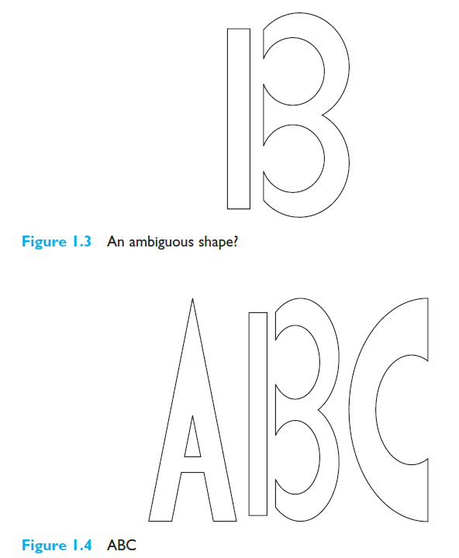
Optical Illusions

Slide 13
Optical Illusions

Slide 14
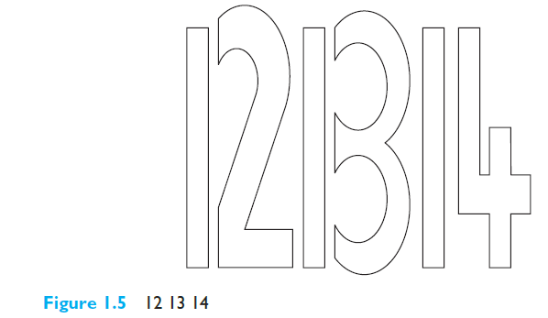
Optical Illusions

Slide 15
Optical Illusions(cont.)
the Ponzo illusion
the Muller Lyer illusion – which line is longer?

Slide 16
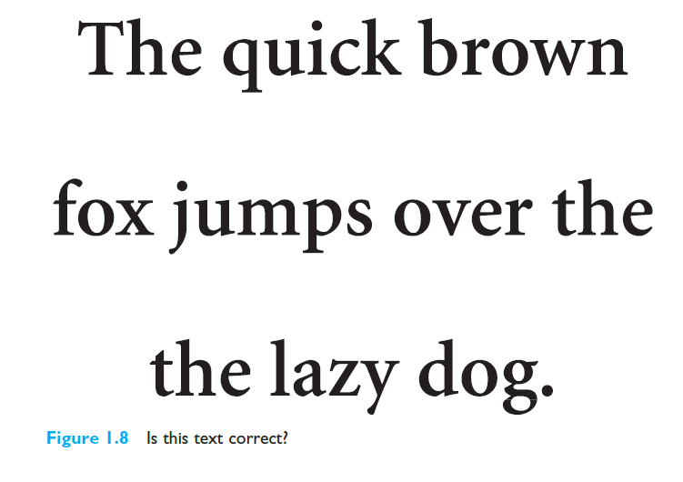
Optical Illusions(cont.)

Slide 17
Reading
Several stages:
visual pattern perceived
decoded using internal representation of language
interpreted using knowledge of syntax, semantics, pragmatics
Reading involves saccades( a rapid movement of eye between fixation points) and fixations
Perception occurs during fixations
Word shape is important to recognition
Negative contrast improves reading from computer screen

Slide 18
Hearing
Provides information about environment: distances, directions, objects etc.
Physical apparatus:
outer ear – protects inner and amplifies sound
middle ear – transmits sound waves as vibrations to inner ear
inner ear – chemical transmitters are released and cause impulses in auditory nerve
Sound
pitch – sound frequency
loudness – amplitude
timbre – type or quality

Slide 19
Hearing (cont)
Humans can hear frequencies from 20Hz to 15kHz
less accurate distinguishing high frequencies than low.
Auditory system filters sounds
can attend to sounds over background noise.
for example, the cocktail party phenomenon.

Slide 20
Touch
Provides important feedback about environment.
May be key sense for someone who is visually impaired.
Stimulus received via receptors in the skin:
thermoreceptors – heat and cold
nociceptors – pain
mechanoreceptors – pressure (some instant, some continuous)
Some areas more sensitive than others e.g. fingers.
Kinethesis - awareness of body position
affects comfort and performance.

Slide 21
Movement
Time taken to respond to stimulus: reaction time + movement time
Movement time dependent on age, fitness etc.
Reaction time - dependent on stimulus type:
visual ~ 200ms
auditory ~ 150 ms
pain ~ 700ms
Increasing reaction time decreases accuracy in the unskilled operator but not in the skilled operator (ex. Playing games)

Slide 22
Movement (cont)
Fitts' Law describes the time taken to hit a screen target:
Mt = a + b log₂(D/S + 1)
where: a and b are empirically determined constants
Mt is movement time
D is Distance
S is Size of target
targets as large as possible distances as small as possible

Slide 23
Memory
There are three types of memory function:
Sensory memories
Short-term memory or working memory
Long-term memory
Selection of stimuli governed by level of arousal.
Attention
Rehearsal

Slide 24
sensory memory
Buffers for stimuli received through senses
iconic memory: visual stimuli
echoic memory: aural stimuli
haptic memory: tactile stimuli
Examples
“sparkler” trail
stereo sound
Continuously overwritten

Slide 25
Short-term memory (STM)
Scratch-pad for temporary recall
rapid access ~ 70ms
rapid decay ~ 200ms
limited capacity - 7± 2 chunks

Slide 26
Examples
212348278493202
0121 414 2626
HEC ATR ANU PTH ETR EET

Slide 27
Long-term memory (LTM)
Repository for all our knowledge
slow access ~ 1/10 second
slow decay, if any
huge or unlimited capacity
Two types
episodic – serial memory of events
semantic – structured memory of facts,concepts, skills
semantic LTM derived from episodic LTM

Slide 28
Long-term memory (cont.)
Semantic memory structure
provides access to information
represents relationships between bits of information
supports inference
Model: semantic network
inheritance – child nodes inherit properties of parent nodes
relationships between bits of information explicit
supports inference through inheritance

Slide 29
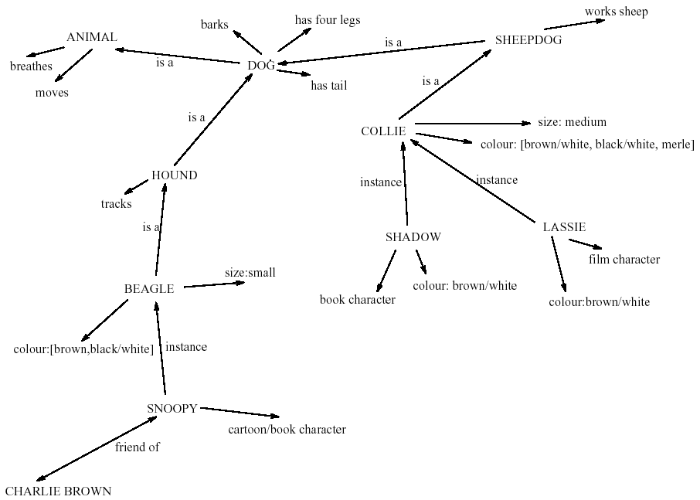
LTM - semantic network

Slide 30
Models of LTM - Frames
Information organized in data structures
Slots in structure instantiated with values for instance of data
Type–subtype relationships
DOG
Fixed
legs: 4
Default
diet: carniverous
sound: bark
Variable
size: colour
COLLIE
Fixed
breed of: DOG
type: sheepdog
Default
size: 65 cm
Variable
colour

Slide 31
Models of LTM - Scripts
Model of stereotypical information required to interpret situation
Script has elements that can be instantiated with values for context
Script for a visit to the vet
Entry conditions: dog ill
vet open
owner has money
Result: dog better
owner poorer
vet richer
Props: examination table
medicine
instruments
Roles: vet examines
diagnoses
treats
owner brings dog in
pays
takes dog out
Scenes: arriving at reception
waiting in room
examination
paying
Tracks: dog needs medicine
dog needs operation

Slide 32
Models of LTM - Production rules
Representation of procedural knowledge.
Condition/action rules
if condition is matched
then use rule to determine action.
IF dog is wagging tail
THEN pat dog
IF dog is growling
THEN run away

Slide 33
LTM - Storage of information
rehearsal
information moves from STM to LTM
total time hypothesis
amount retained proportional to rehearsal time
distribution of practice effect
optimized by spreading learning over time
structure, meaning and familiarity
information easier to remember

Slide 34
LTM - Forgetting
decay
information is lost gradually but very slowly
interference
new information replaces old: retroactive interference
old may interfere with new: proactive inhibition
so may not forget at all memory is selective …
… affected by emotion – can subconsciously `choose' to forget

Slide 35
LTM - retrieval
recall
information reproduced from memory can be assisted by cues, e.g. categories, imagery
recognition
information gives knowledge that it has been seen before
less complex than recall - information is cue

Slide 36
Thinking
How information is processed and manipulated.
Most complex area and separates humans from other information-processing systems, both artificial and natural.
Although, animals receive and store information, there is little evidence to suggest that they can use it in quite the same way as humans.
Similarly, artificial intelligence can store information but their ability to use that information is limited to small domains.

Slide 37
Thinking(cont.)
Human thought is conscious and self-aware: while we may not always be able to identify the processes we use, we can identify the products of these processes, our thoughts.
We are able to think about things of which we have no experience, and solve problems which we have never seen before. How is this done?
Thinking can require different amounts of knowledge.
Some thinking activities are very directed and the knowledge required is constrained.
Ex: Performing subtraction (constrained domain), understanding newspaper headlines demands knowledge of politics, social structures, public figures and world events.

Slide 38
Categories of Thinking
Reasoning is the process by which we use the knowledge we have to draw conclusions or infer something new about the domain of interest.
Types – 3 : deduction, induction, abduction
Problem solving is the process of finding a solution to an
unfamiliar task, using the knowledge we have.

Slide 39
Deductive Reasoning
Deduction:
derive logically necessary conclusion from given premises.
e.g. If it is Friday then she will go to work
It is Friday
Therefore she will go to work.
Logical conclusion not necessarily true:
e.g. If it is raining then the ground is dry
It is raining
Therefore the ground is dry

Slide 40
Deduction (cont.)
When truth and logical validity clash …
e.g. Some people are babies
Some babies cry
Inference - Some people cry
Correct?

Slide 41
Deduction (cont.)
When truth and logical validity clash … (cont.)
This is in fact an invalid deduction.
Since we are not told that all babies are people.
It is therefore logically possible that the babies who cry are those who are not people.
People bring their world knowledge into the reasoning process.
We assume a certain amount of shared knowledge in our dealings with each other, which in turn allows us to interpret the inferences and deductions implied by others.
If validity rather than truth was preferred, all premises would have to be made explicit.

Slide 42
Inductive Reasoning
Induction:
generalize from cases seen to cases unseen
e.g. all elephants we have seen have trunks therefore all elephants have trunks.
Unreliable:
can only prove false not true
… but useful because we use it constantly in learning about our environment
Humans not good at using negative evidence
e.g. Wason's cards.

Slide 43
Wason's cards
7 E 4 K
If a card has a vowel on one side it has an even number on the other
Is this true?
How many cards do you need to turn over to find out?
…. and which cards?

Slide 44
Wason's cards (cont.)
Common response: check the E and the 4.
However, this uses only positive evidence.
Test the truth : check negative evidence - Ex: E and 7 (odd number).
It does not matter what is on the other side of the other cards: the statement does not say that all even numbers have vowels, just that all vowels have even numbers.)

Slide 45
Abductive reasoning
Reasoning from event to cause
e.g. Sam drives fast when drunk.
If I see Sam driving fast, assume drunk.
Unreliable:
can lead to false explanations
Ex: since there may be another reason why she is driving fast: she may have been called to an emergency.
Explanation: If an event always follows an action, the user will infer that the event is caused by the action unless evidence to the contrary is made available. If, in fact, the event and the action are unrelated, confusion and even error often result.

Slide 46
Problem solving
Process of finding solution to unfamiliar task using knowledge.
Several theories.
Gestalt
problem solving both productive and reproductive.
reproductive problem solving draws on previous experience as the behaviorists claimed, productive draws on insight and restructuring of problem.
attractive but not enough evidence to explain `insight' etc.
move away from behaviourism and led towards information processing theories.

Slide 47
Problem solving (cont.)
Problem space theory (Newell and Simon)
problem solving centers on the problem space
problem space comprises problem states
problem solving involves generating these states using legal state transition operators.
heuristics may be employed to select operators e.g. means-ends analysis
operates within human information processing system e.g. STM limits etc.
largely applied to problem solving in well-defined areas e.g. puzzles rather than knowledge intensive areas

Slide 48
Problem solving (cont.)
Analogy
analogical mapping:
novel problems in new domain?
use knowledge of similar problem from similar domain
analogical mapping difficult if domains are semantically different
Skill acquisition
skilled activity characterized by chunking
lot of information is chunked to optimize STM
conceptual rather than superficial grouping of problems
information is structured more effectively

Slide 49
Errors and mental models
Types of error
slips
right intention, but failed to do it right
causes: poor physical skill,inattention etc.
change to aspect of skilled behaviour can cause slip
mistakes
wrong intention
cause: incorrect understanding
humans create mental models to explain behaviour.
if wrong (different from actual system) errors can occur

Slide 50
Emotion
Our emotional response to situations affects how we perform.
For example, positive emotions enable us to think more creatively, to solve complex problems, whereas negative emotion pushes us into narrow, focussed thinking.
A problem that may be easy to solve when we are
relaxed, will become difficult if we are frustrated or afraid.

Slide 51
Emotion (cont.)
Various theories of how emotion works
James-Lange: emotion is our interpretation of a physiological response to a stimuli
Cannon: emotion is a psychological response to a stimuli
Schacter-Singer: emotion is the result of our evaluation of our physiological responses, in the light of the whole situation we are in
Emotion clearly involves both cognitive and physical responses to stimuli

Slide 52
Emotion (cont.)
The biological response to physical stimuli is called affect.
Affect influences how we respond to situations
positive → creative problem solving
negative → narrow thinking
“Negative affect can make it harder to do even easy tasks; positive affect can make it easier to do difficult tasks”
(Donald Norman)

Slide 53
Emotion (cont.)
Implications for interface design
stress will increase the difficulty of problem solving
relaxed users will be more forgiving of shortcomings in design
This does not give us an excuse to design bad interfaces but does suggest that if we build interfaces that promote positive responses
– for example by using aesthetics or reward then they are likely be more successful.

Slide 54
Individual differences
Here, discussion about human is done in general.
To some extent this is true: the psychological principles and properties that we have discussed apply to the majority of people.
Although we share processes in common, humans, and therefore users, are not all the same

Slide 55
Individual differences (cont.)
long term – gender physical and intellectual abilities
short term – effect of stress or fatigue
changing – age
Ask yourself: will design decision exclude section of user population?

Slide 56
Psychology and the Design of Interactive System
Some direct applications
e.g. blue acuity is poor ⇒ blue should not be used for important detail
However, correct application generally requires understanding of context in psychology, and an understanding of particular experimental conditions
A lot of knowledge has been distilled in
guidelines (chap 7)
cognitive models (chap 12)
experimental and analytic evaluation techniques (chap 9)

